Slide 1
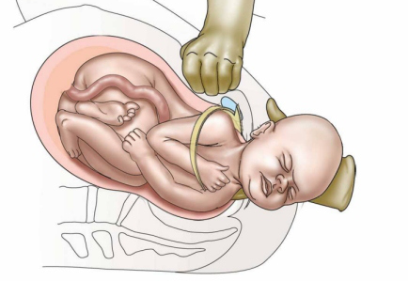
Shoulder Dystocia
Kipp Johnson

Slide 2
Biological and historical perspective

Slide 3
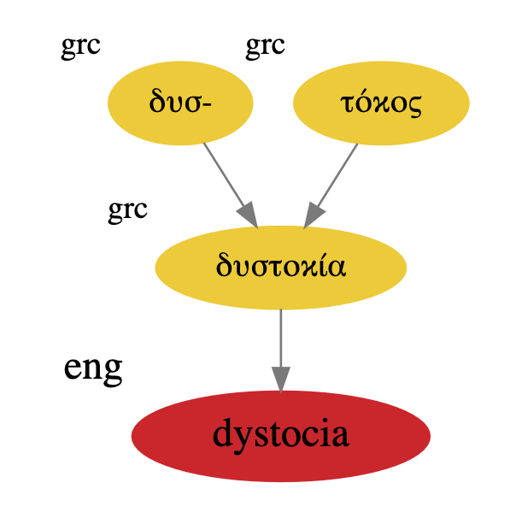
Etymology of Dystocia
Dus (dys) - Bad
tokos (tocia) - Childbirth

Slide 4

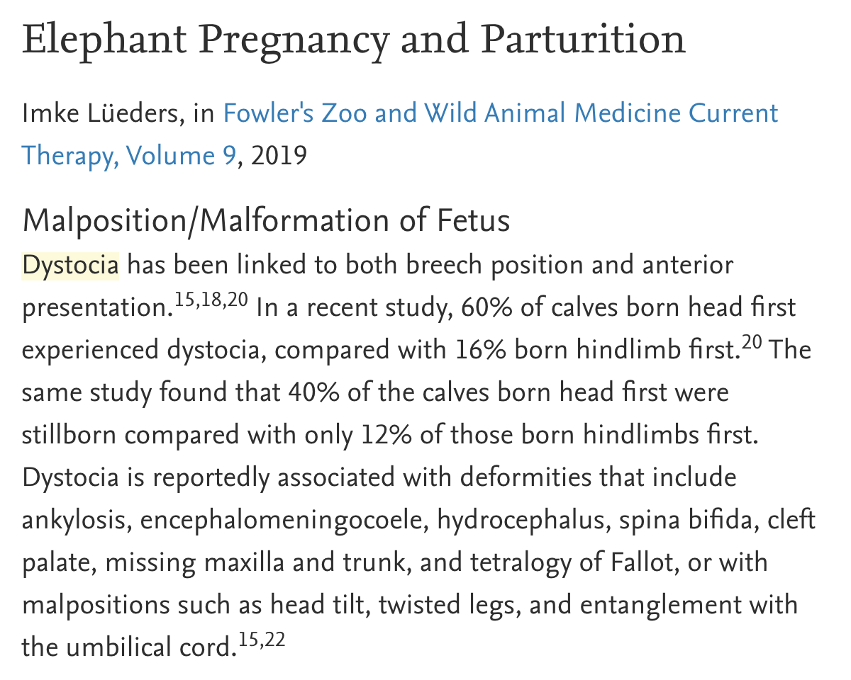
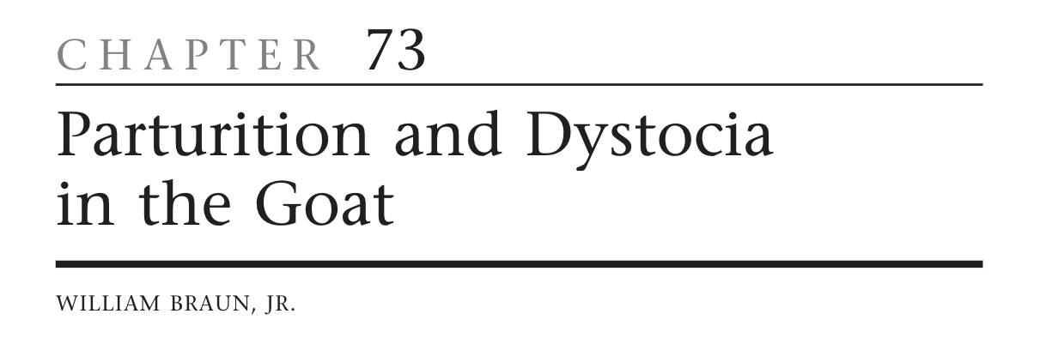


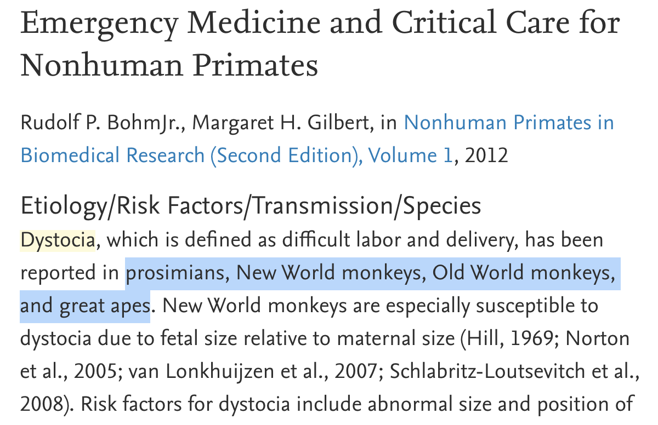
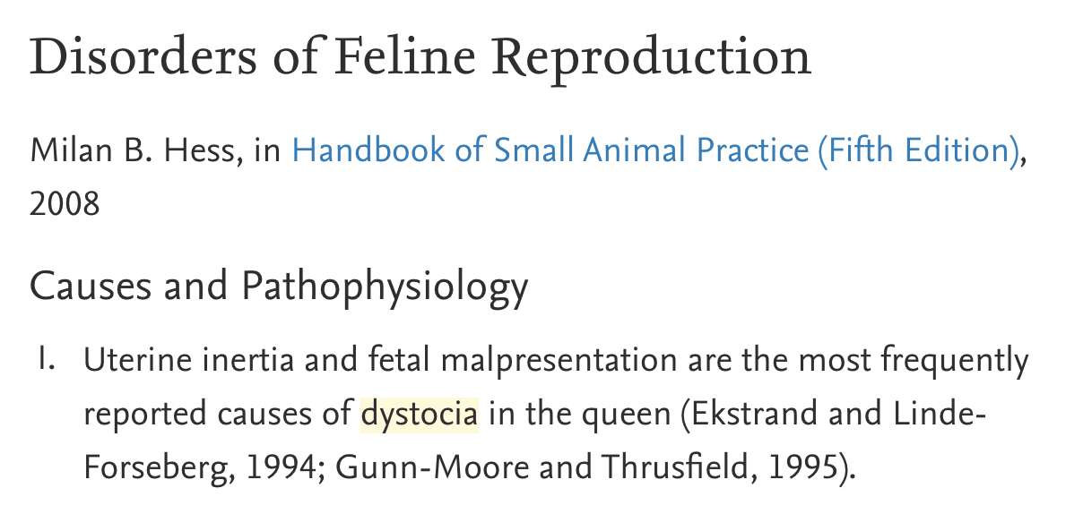


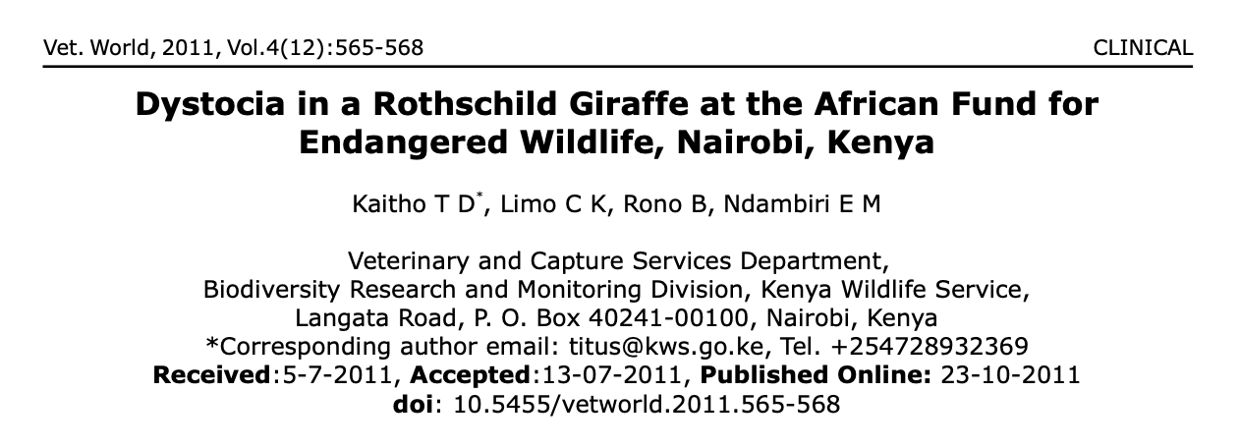
Not a uniquely human disorder

Slide 5
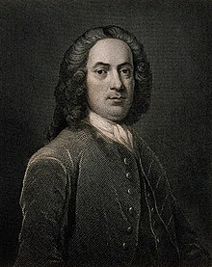
Called to a gentlewoman in labor. The child's head delivered for a long time -- but even with horrid pulling from the midwife, the remarkably large shoulder prevented delivery. I have been called by midwives to many cases of this kind, in which the child was frequently lost.
William Smellie, Born 1697
”father of British midwifery”

Slide 6
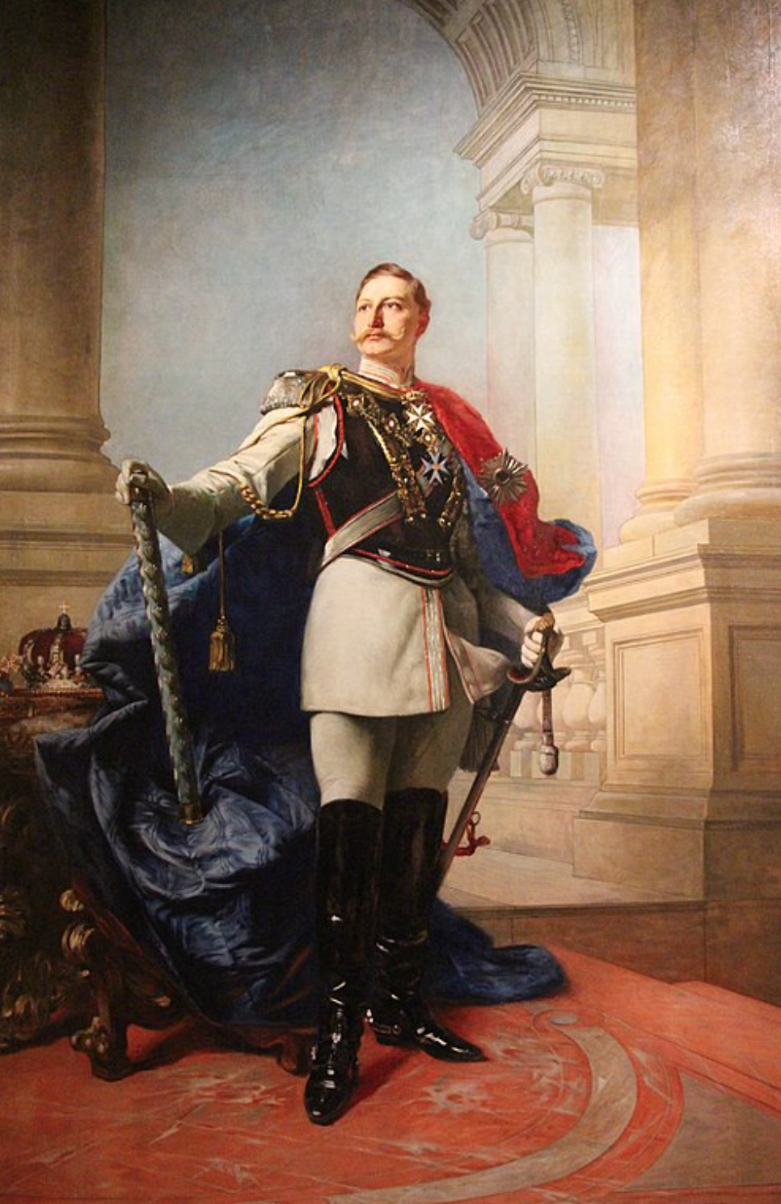

Slide 7
Kaiser Wilhelm II
Last Emperor of Germany
(painting)
Notes:
This is a PAINTING

Slide 8
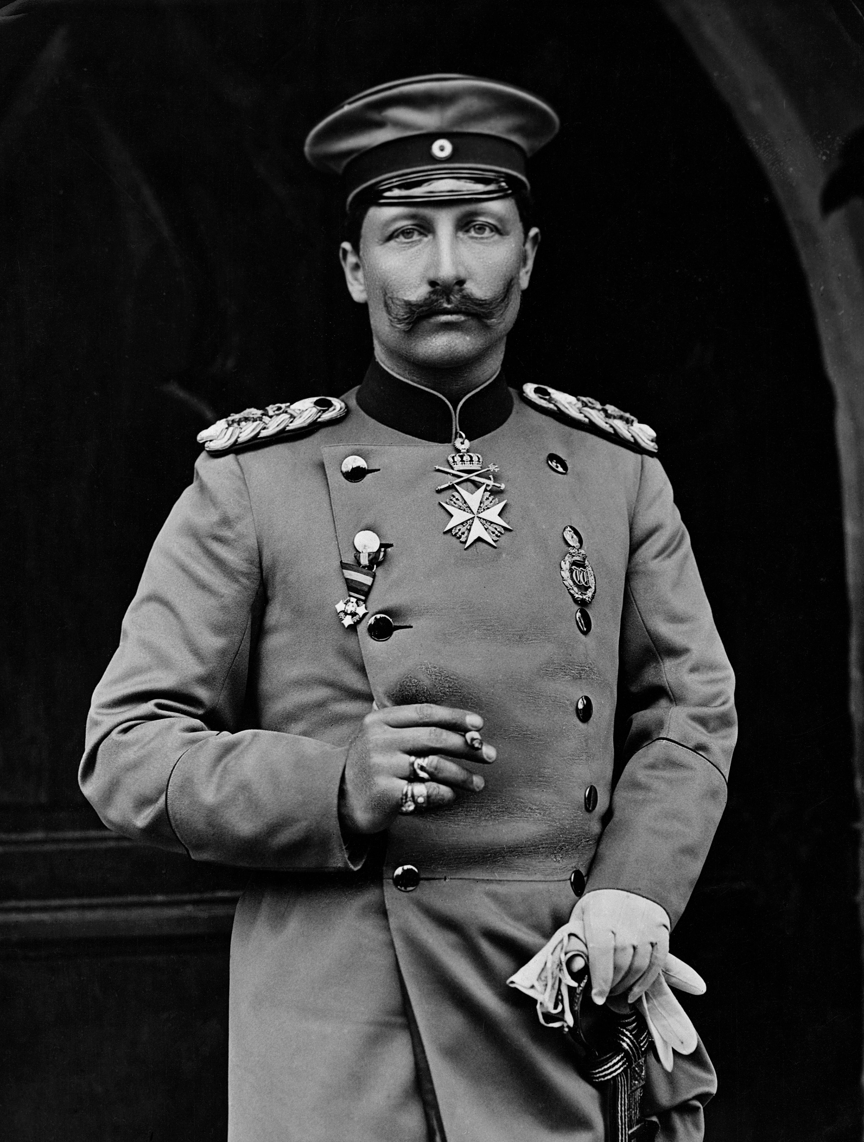
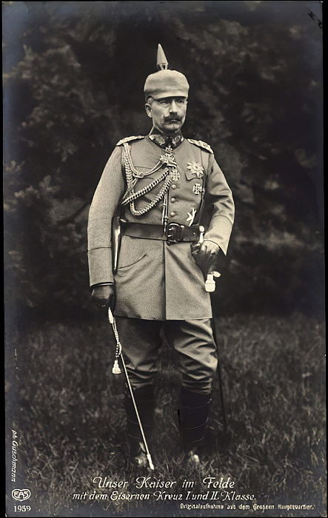
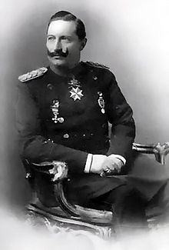
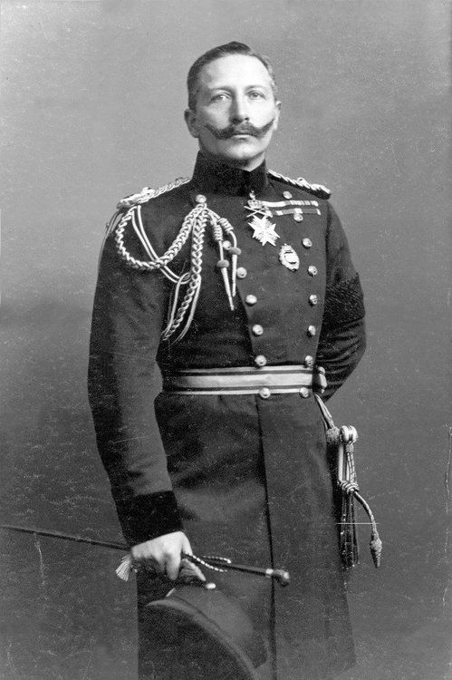

Slide 9
Kaiser Wilhelm II suffered severe shoulder dystocia during birth, which left his left arm withered and unusable
“An English doctor killed my father, and an English doctor crippled my arm, which was the fault of my mother”
… and his mother was English
Notes:
Queen Victoria mother, only allowed family to see English doctors

Slide 10

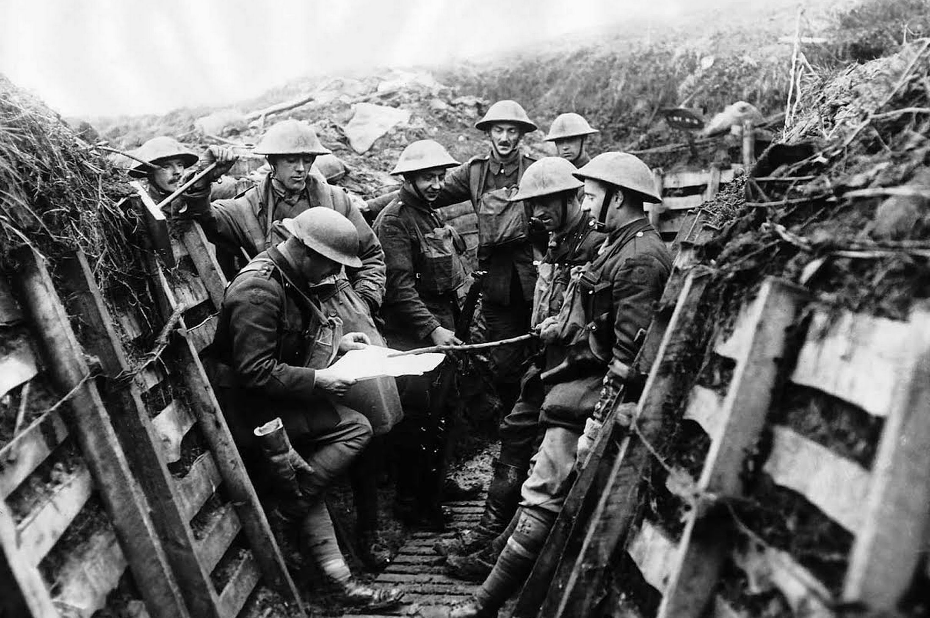
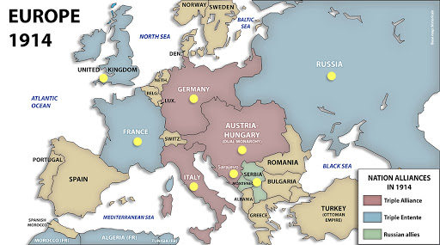
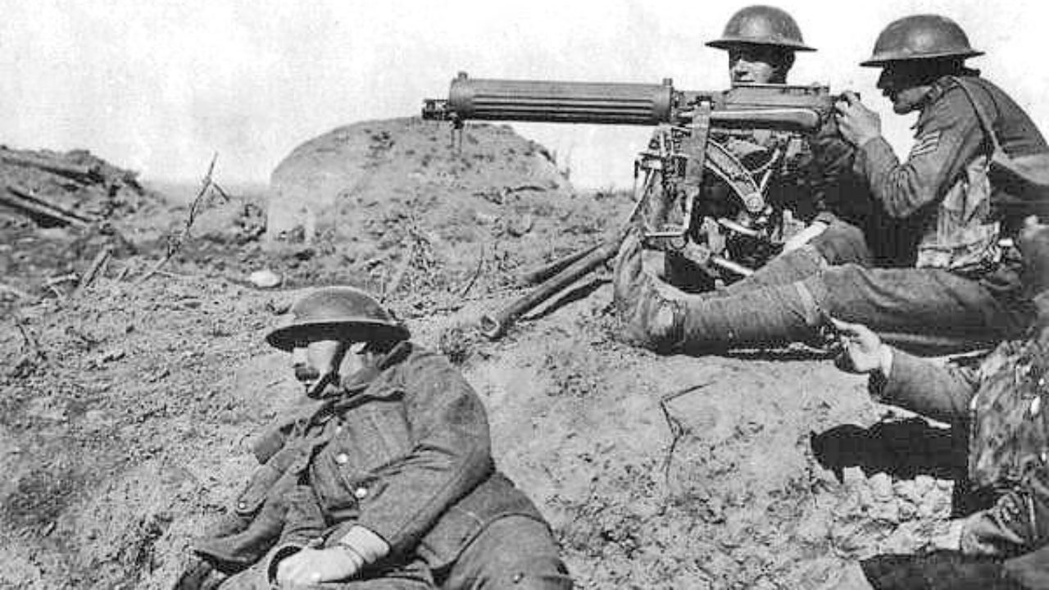
Notes:
Historians have speculated his insecurities around his withered arm 2/2 erb’s palsy from shoulder dystocia lead to his willingness to start WW1

Slide 11
Problems during labor can result in severe and long-lasting deficits
Notes:
Historians have speculated his insecurities around his withered arm 2/2 erb’s palsy from shoulder dystocia lead to his willingness to start WW1

Slide 12
Case Presentation

Slide 13
Case Presentation
CC: Labor, non-reassuring fetal heart tracing
HPI: NB is a 24 y.o. G1P0 @ 41w3d BIBEMS presenting in active labor, transferred from the Jazz Center [nearby birthing center] for a non-reassuring fetal heart tracing. Contractions are occurring every 2-3 minutes and are painful. Uncomplicated pregnancy to date with consistent care. No prenatal records are available.

Slide 14
Medications: Prenatal vitamins
Allergies: None
OB history: G1P000
GYN history: WNL
Past medical history: None
Past surgical history: None
Family History: NA

Slide 15
Physical Exam
Vitals: Temp 36.1°C, HR: 110, RR 18, BP 117/65 SpO2 99%
General: Young woman in moderate distress, odd affect
Cardiovascular: RRR, Normal S1/S2, Tachycardia
Pulmonary: CTAB
Abdominal: Soft, nontender, nondistended, no rebound, no guarding, fundus firm.
Pelvic: No bleeding. Cervix dilated to 9CM and 100% effaced.

Slide 16
Labs and Imaging
Labs:
Type + Screen: O+
CBC – WBC 21.4 (99% PMNs), HgB 12.6, HCT 39.4
Transabdominal ultrasound: Vertex presentation, anterior placenta, EFW 3000g
EKG: Sinus Tachycardia
Fetal Heart Rate Tracing: Recurrent variable decelerations, moderate variability (Class II)

Slide 17
Hospital Course
Pt initially declines epidural or other intervention (blood transfusions)
Recurrent decelerations to 90 BPM, temporarily resolves with fetal scalp massage. Scalp electrode placed.
Return to room in <1 hour, patient kneeling on bed beginning to give birth.
After re-positioning, patient laboring successfully until shoulder presentation with nuchal cord.

Slide 18
Shoulder!!!

Slide 19
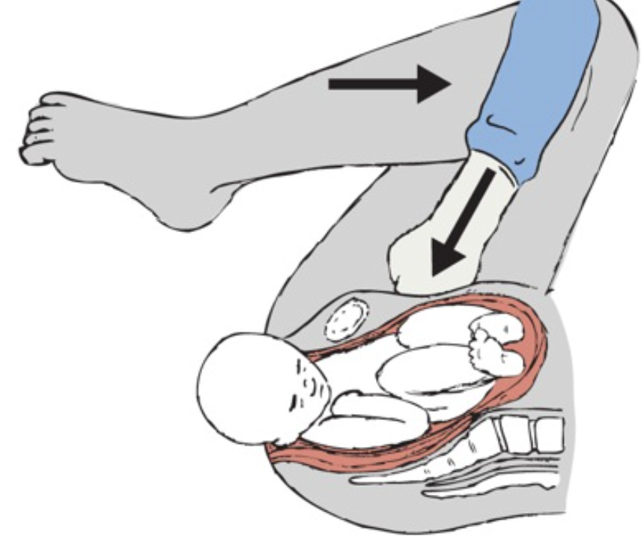
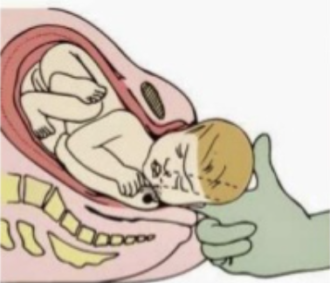
McRobert’s maneuver performed
Wood’s screw maneuver

Slide 20
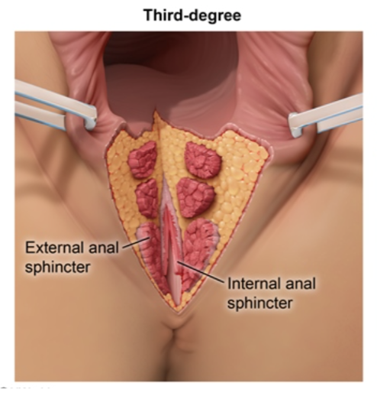
Case Conclusion
< 60 seconds of shoulder dystocia
3650g (8 lb) infant, transferred to NICU
Poor respiratory effort, acidemia
3rd degree perineal laceration

Slide 21
Differential diagnosis
Known shoulder dystocia

Slide 22
Epidemiology
Definition: Failure to deliver fetal shoulder or shoulders with gentle downward traction on the fetal head, requiring other obstetric maneuvers
Incidence: 0.2% - 3.0% of NSVD depending upon definition used and study population
Notes:
Some group have used definitions of head-toi-boidy delivery time (60 seconds or 2SDs above mean)

Slide 23
Risk Factors
ACOG Practice Bulletin 178: “An unpredictable and unpreventable obstetric emergency […] prepregnancy, antepartum, and intrapartum risk factors have extremely poor predictive value for shoulder dystocia”
About 50% of SD pregnancies have no identifiable risk factors

Slide 24
Risk Factors
High birth weight
maternal DM
Previous shoulder dystocia (recurrence rate >10%)
post-term pregnancy
male fetal sex
maternal obesity
advanced maternal age
operative vaginal delivery
precipitous or prolonged labor,

Slide 25
Pathophysiology
Descent of fetal head while anterior or posterior shoulder remain obstructed
Fetal bisacromial diameter typically enters pelvis obliquely with posterior shoulder ahead of anterior shoulder; if the shoulders remain A-P during descent, anter shoulder can become impacted on symphysis pubis or posterior shoulder on sacral promontory
Mechanical comperssion leads to symptoms

Slide 26
Major Complications
About 95% of the time, no major complications
Brachial plexus injury [Transient or Permanent] (Erb’s palsy)
Clavicular fracture
Humeral fracture
Neonatal asphyxia: Especially if infant is “stuck” for > 5 minutes
Death
Maternal: 3rd and 4th degree lacerations, hemorrhage
Notes:
Evidence for rates of complications vary widely

Slide 27
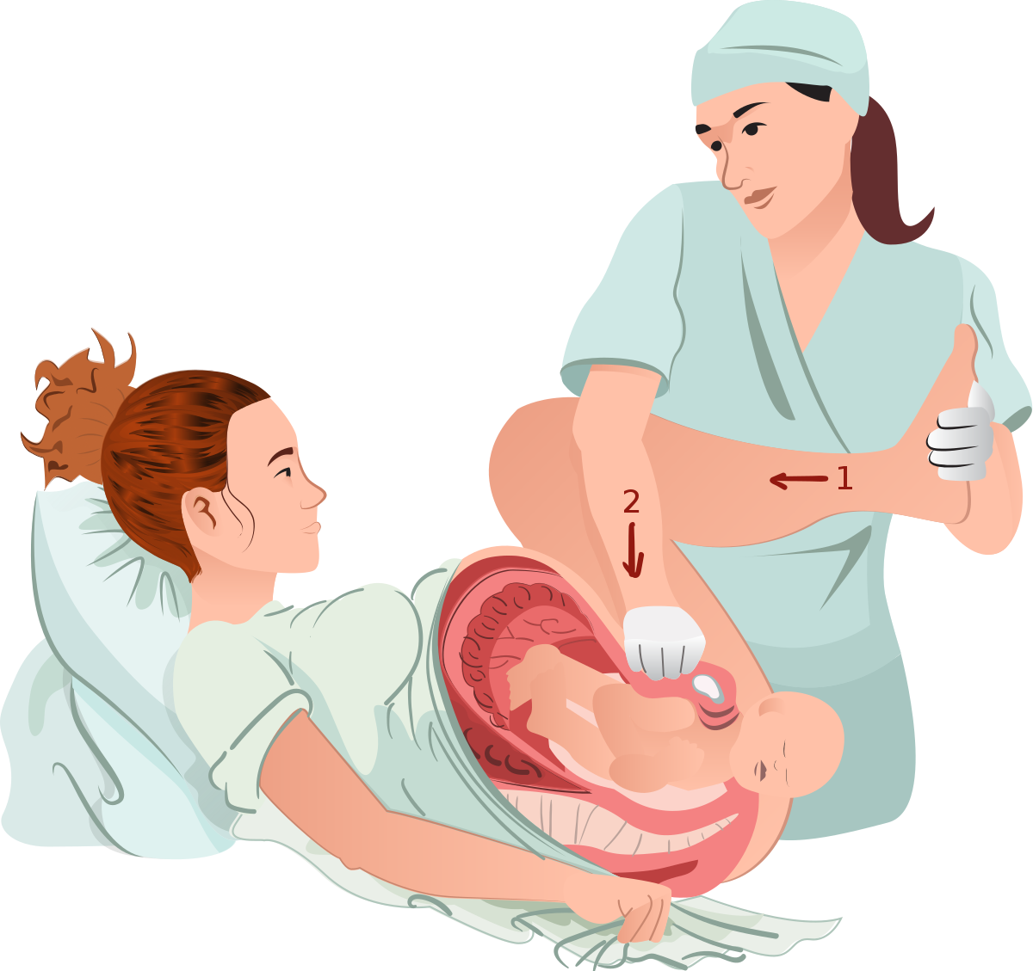
Management
McRobert’s Maneuver ± Suprapubic pressure
Two assistants grasp legs and flex backwards causing cephalad rotation of symphysis pubis and flattening of lordosis, freeing shoulder

Slide 28
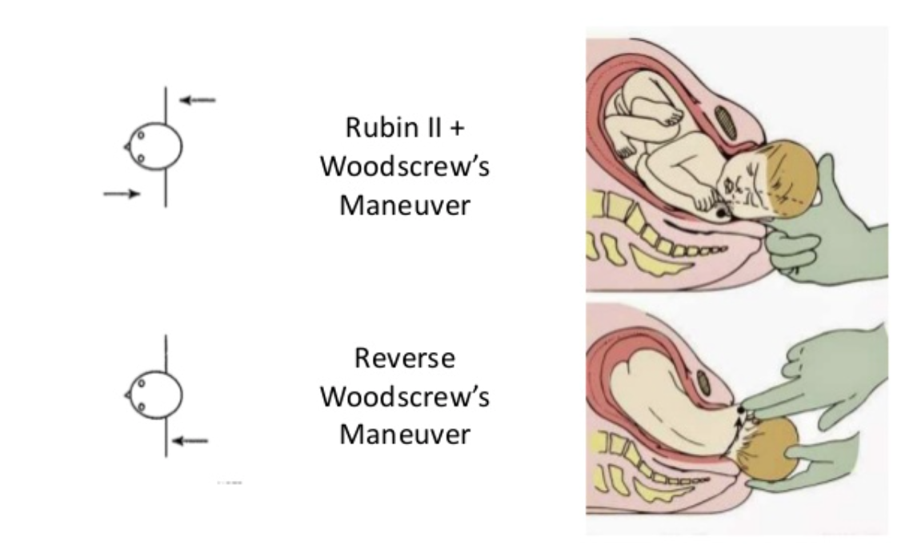
Other Treatments
No evidence exists for superiority of other maneuvers
Rubin maneuver, Woods Screw maneuver

Slide 29
Gunn-Zavanelli-O’Leary: Last resort
Give terbutaline or nitroglycerine
Place fetal scalp electrode
Rotate head back to occiput anterior and push back into uterus as far as possible
Deliver via stat C-section

Slide 30
Thank you!
Questions?

